Slide 1

Challenge Webinar
Everything you need to know to participate
September 10, 2015

Slide 2
Webinar Outline
For details please visit the AstraZeneca-Sanger DREAM Challenge Wiki: https://www.synapse.org/#!Synapse:syn4231880
Send questions during the webinar using the “Question” box
Introduction to DREAM
Challenge Introduction – problem of combination therapy
Data overview
Challenge Questions and Scoring
Challenge Timelines, Scoring Rounds and Leaderboards
Challenge Incentives
Live Demo (registration, downloading data, submitting and leaderboard)
Questions & Answers Session

Slide 3


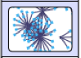
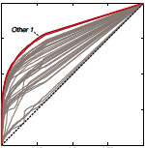
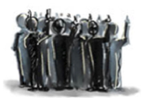
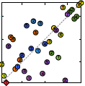
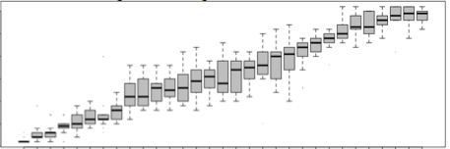
Dialogue for Reverse Engineering Assessments and Methods
DREAM Challenges pose fundamental questions about systems biology and translational medicine. Designed and run by a community of researchers from a variety of organizations, our challenges invite participants to propose solutions — fostering collaboration and building communities in the process. Expertise and institutional support are provided by Sage Bionetworks, along with the infrastructure to host challenges via their Synapse platform.
Together, we share a vision allowing individuals and groups to collaborate openly so that the “wisdom of the crowd” provides the greatest impact on science and human health.
Design
Open Challenge
Scoring
Pose
Challenge
to the
Community
Challenge
Train
Test

Slide 4
Acknowledgements: challenge partners
AstraZeneca – provides largest drug combination screening available to date
Sanger Institute – provides comprehensive molecular characterization of the cell lines
DREAM organizers: Sage Bionetworks, EMBL-EBI, RWTH Aachen (JRC-COMBINE), IBM

Slide 5
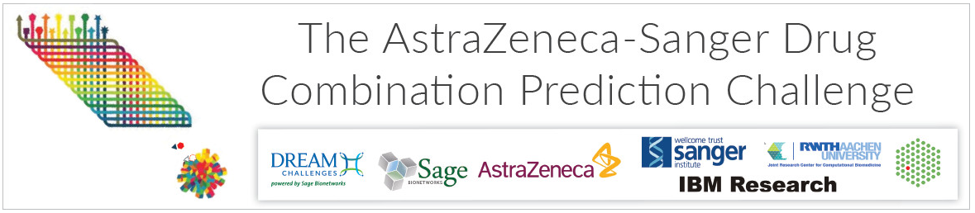
The goal of this challenge is to accelerate our understanding of drug synergy, and the biomarkers that determine a patient’s response.
Many patients benefit from drugs targeting a molecular defect in tumor cells.
But numerous patients do not respond, or develop drug resistance.
Targeting multiple mechanisms with multiple drugs can enhance benefit.
Selecting the right combination for the right patient is very complex.
Through the various sub-challenges we encourage participants to derive predictive algorithms/insight ‘actionable’ in realistic clinical practice:
Establishing prediction rules from prior knowledge.
Limited to measurements taken prior to treatment.
Limiting to DNA variants only (translation to a clinical diagnostic).
Visible rationalized predictive rule-sets (chance of validation
& regulatory approval).

Slide 6
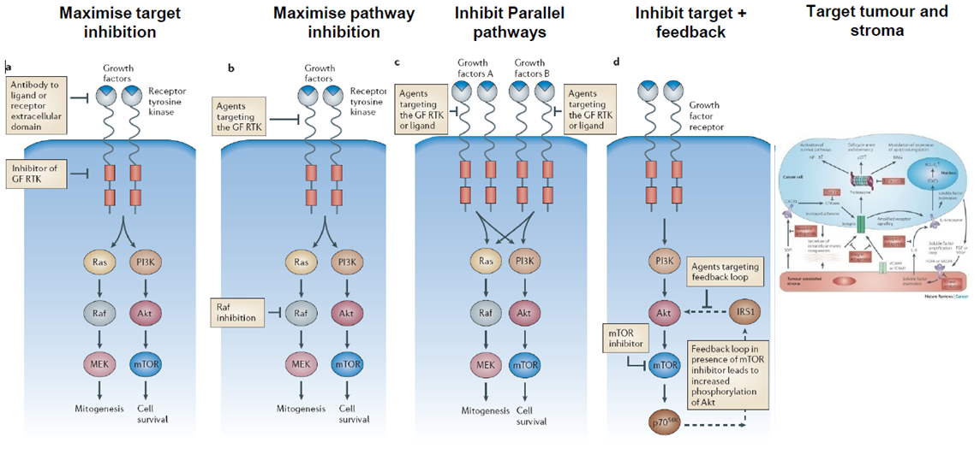
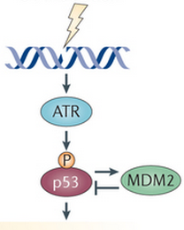
We encourage you to consider knowledge-led approaches:
What biological mechanisms can lead to combination synergy?
Induce a sensitized phenotype
(inc. immune)
DNA damage
Ref: Nature Reviews Cancer
How do these mechanisms translate to biomarker relationships?
What knowledge sources (pathway databases etc.) can be leveraged?
How can this information be leveraged computationally, and captured as rules/rationale for biomarker selection and prediction of response?

Slide 7
Description of Challenge Data Overview
85 cancer cell lines across 6 tissue types (gastrointestinal, lung, breast, melanoma, urinary tract, and lymphatic)
AstraZeneca pharmacology data:
Combination synergy: 912 unique combinations screened in 11,759 experiments
Matched monotherapy response: 119 unique compounds
Compound information (structure and chemical properties)
Sanger cell line molecular data:
From naïve cell lines (no pre-treatment)
Mutation, copy number, gene expression and DNA methylation
Raw data available to extract additional features

Slide 8
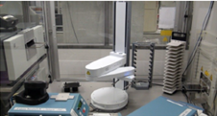
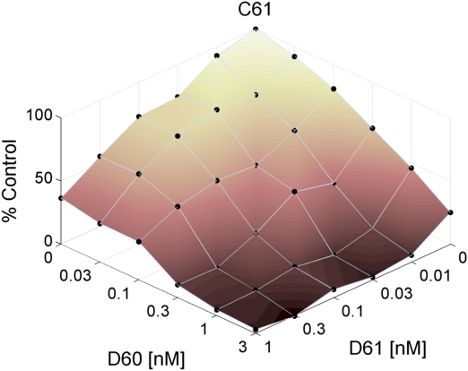
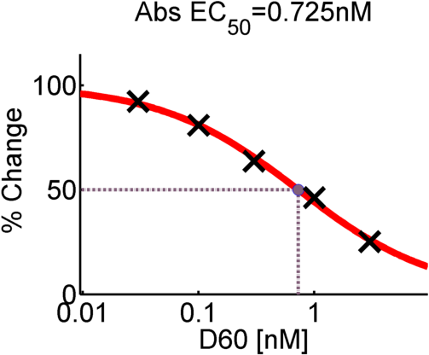
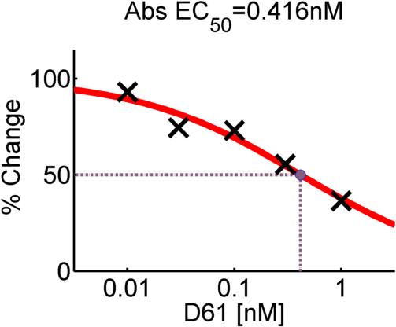
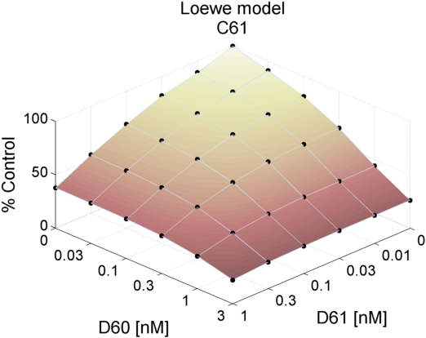
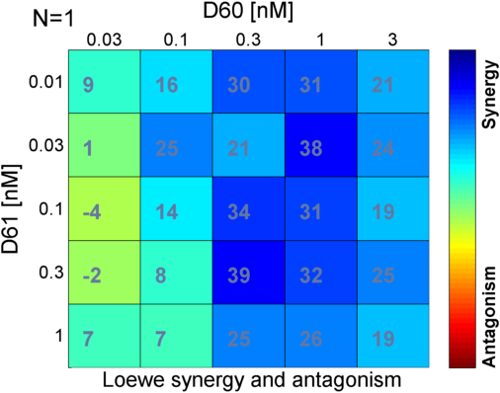
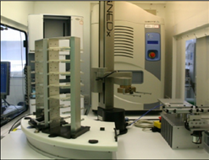
Pharmacology: Combinations analyses
Experiment
Loewe Model
(Isobole equation)
http://sourceforge.net/projects/combenefit

Slide 9
Drug compound information
Targets
- used as compound names (except for some chemos)
- known mutations, genes, protein families
Chemical properties
58 AZ compounds
Molecular weight, polarity, solubility, lipophilicity
Structure
101 compounds with searchable SMILES and/or PubChem IDs
Notes:
Some chemical properties are hidden due to IP restrictions, but offers the opportunity for participants to predict response in novel compounds

Slide 10
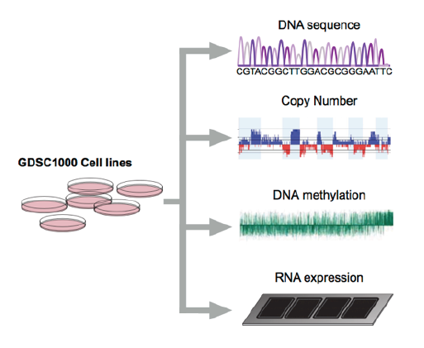
Sanger molecular profiling of cell lines
Whole exome: mutations called by CAVEMAN & PINDEL
SNP6.0 array: CNV segments called by PICNIC
450K array: CpG probes and CpG islands
U219 array: RMA normalized with “affy”
+ Tissue of origin
"Adapted from Iorio et al 2015 Submitted (ie. GDSC1000)”
Notes:
Links to raw data (eg. bam files and cel files) on the wiki

Slide 11
Processed molecular data
85 cell lines from COSMIC with drug combinations data
Mutations: Annotated variants and sample information
Copy number: copy number counts for genes and segments
Gene expression: log2 transformed intensity values
DNA methylation: M and beta values with probe and island positions
Post-processing options:
HUGO gene names and normalized cell line names can be used to integrate other data sources (or prior knowledge)
Further simplification of genomic features (eg. binary or categorical values, gene level)
Notes:
We want input features that will make good clinical biomarkers, therefore, we want simplicity in our molecular data without losing too much information.
Post-processing: focus on getting clinically translatable biomarkers

Slide 12
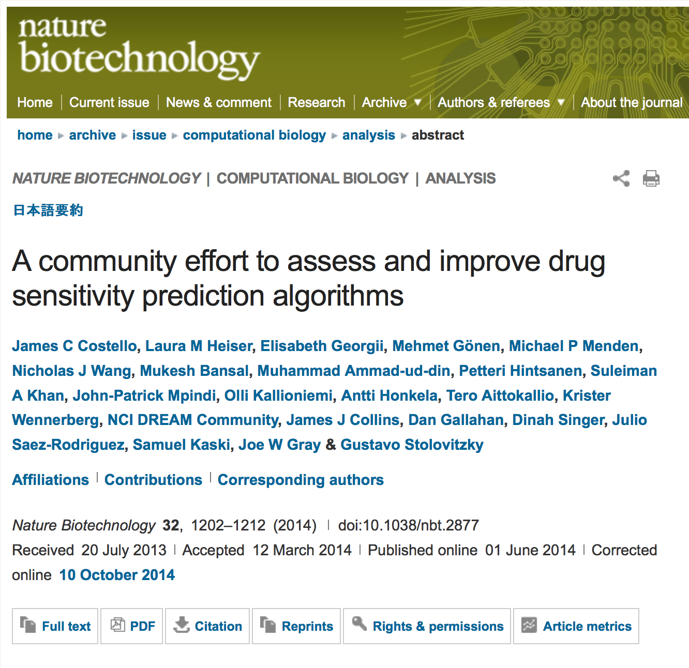
DREAM10: AZ and Sanger DREAM of Synergy 3 years later what is new this time?
Scale:
~129 times more
combinations screened
DREAM7
DREAM10
Scale:
85 times more cell lines
Across 5 tissue types
(mainly breast, lung and GI tract)
DREAM10
DREAM7
B-Cell
(OCI-LY3)

Slide 13
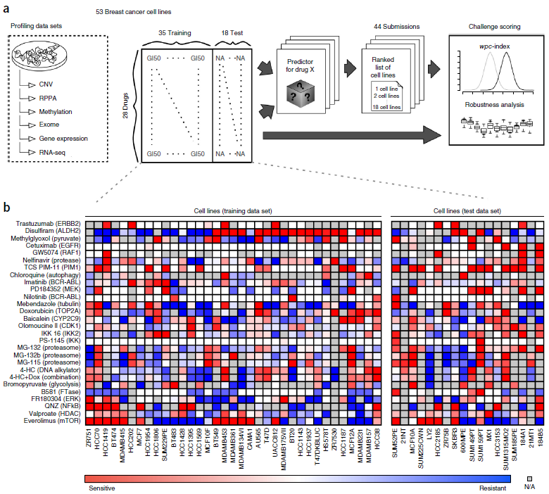

Slide 14
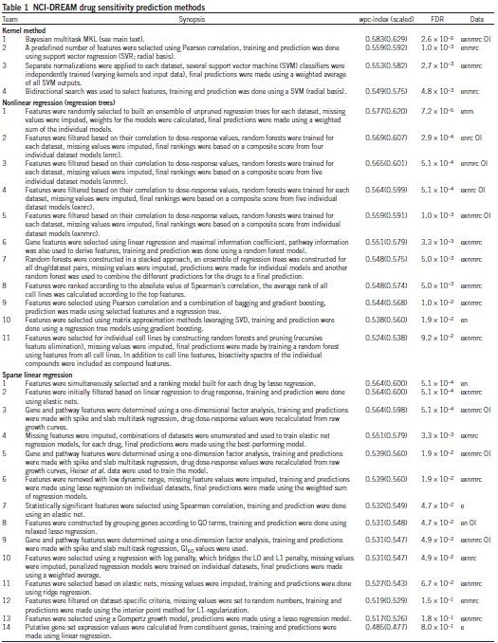
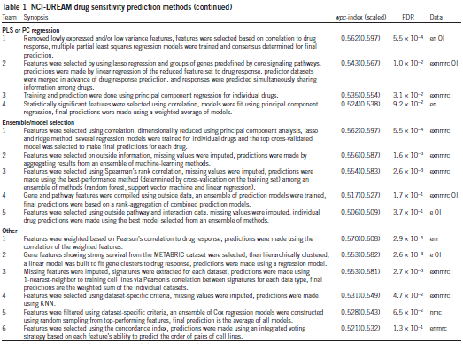

Slide 15
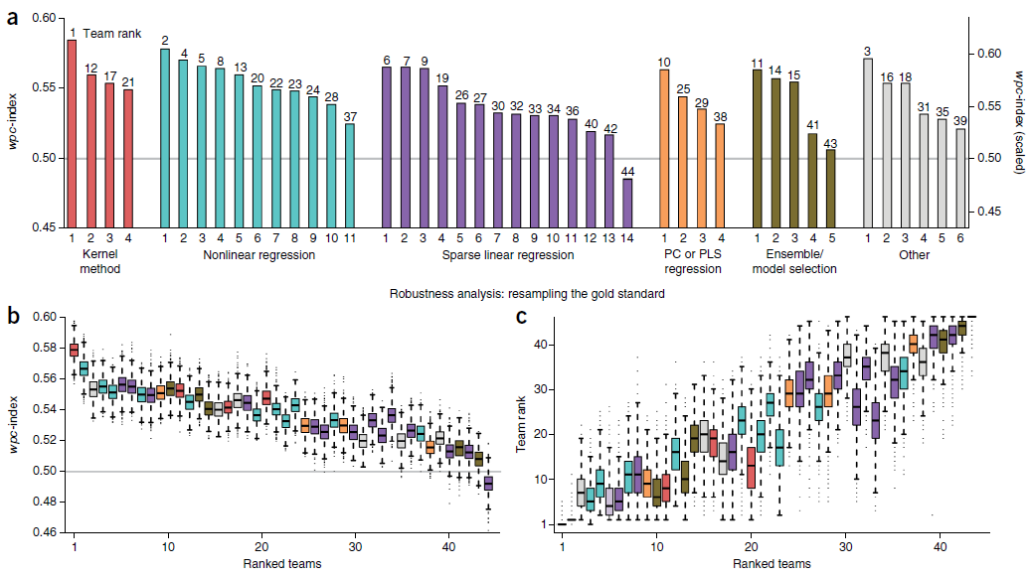
We found that gene expression microarrays consistently provided the best predictive power of the individual profiling data sets; however, performance was increased by including multiple, independent data sets.
The top-performing methodology: Bayesian multitask MKL.
Over a period of 5 months, 127 researchers focused their time and efforts on addressing the challenge of drug sensitivity prediction.

Slide 16
DREAM10: AZ and Sanger DREAM of Synergy 3 years later what is new this time?
DREAM7
DREAM10
difference
basal features:
GEX
+ treatment
GEX
CNV, mut., methyl. & GEX
predict
Synergy & Antagonism
Possible as
Clinical trial?
Ethical test
in patients?
Biomarkers?
Signatures?
DREAM7
✗
✗
✗
✔
DREAM10
✔
✔
✔
✔

Slide 17
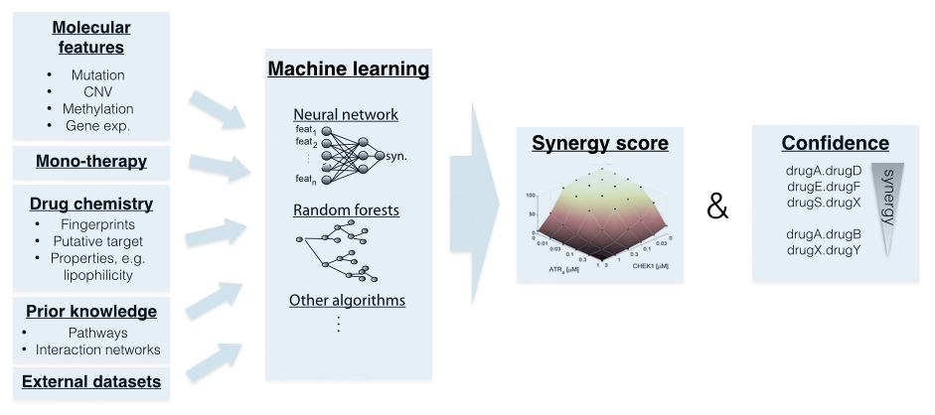
Subchallenge 1A: “Black-box” with all available data

Slide 18
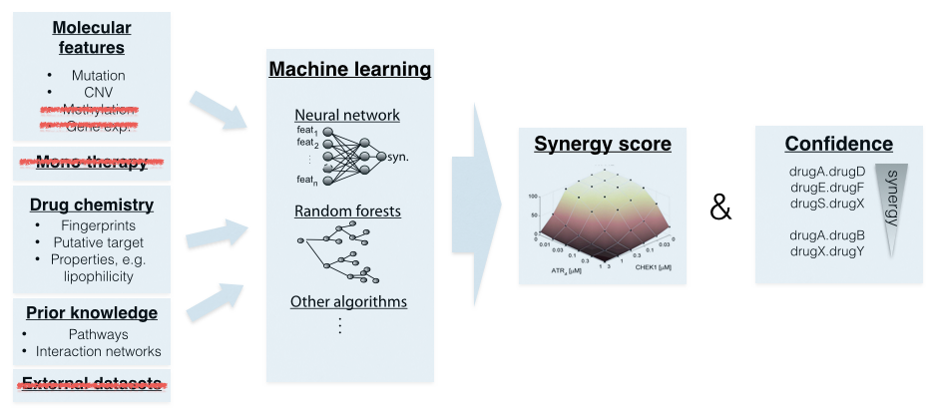
Subchallenge 1B: Restricted to Mutations and CNVs
Why restricting experimental readouts?
=> More clinically applicable and relevant

Slide 19
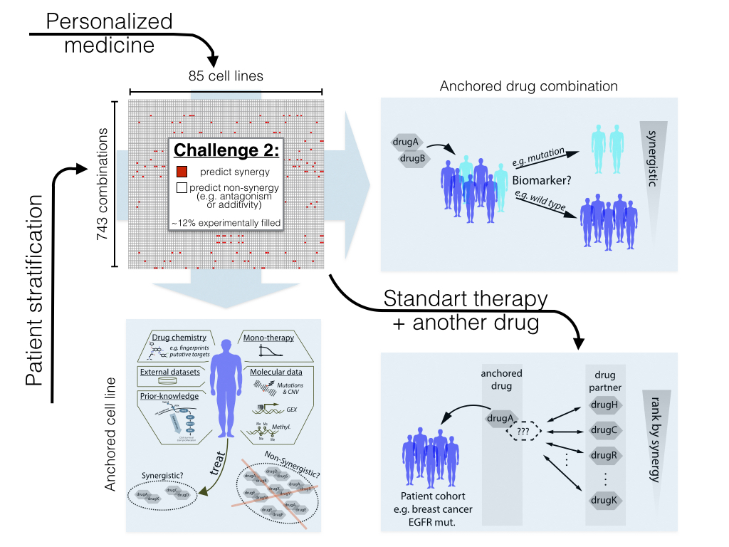
Subchallenge 2

Slide 20
Scoring will be finalized on 18th September
Subchallenge 1A & 1B
Subchallenge 2
synergy
synergy score
frequency
pos.
effect
synergy score
predict
non-synergy
predict
synergy
antagonism
Note:
e.g. Pearson correlation
for capturing outliers,
but no ranked metric (e.g. not Spearman)

Slide 21
Synergy data splitting for challenges
Subchallenge 1:
Final testset
Leaderboard
Trainset
NA or QA < 1
910 drug combinations
Subchallenge 2:
Final testset
Leaderboard
85 cell lines

Slide 22
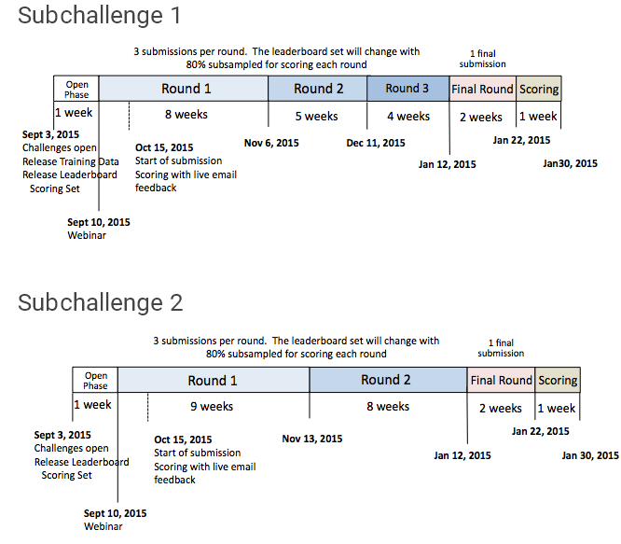
Challenge Timeline, Rounds and Leaderboard Subchallenge 1 & 2
18

Slide 23
Challenge Incentives
Nature Biotechnology. Winning teams will be invited to be coauthors on a manuscript submitted to Nature Biotechnology. All participants* will be invited to be part of the “AstraZeneca-Sanger Drug Combination DREAM Community.” The Community will be a coauthor on the paper submission as well. * participation requires submission of predictions along with a write-up of the methodology to be included in the publication
DREAM Conference. Winning teams will be invited to present at an upcoming RegSys Recomb/DREAM Conference.
F1000. All participants eligible to publish in F1000 DREAM challenge channel

Slide 24

Q & A
Submit your questions through the webinar “Question” box

